Slide 1
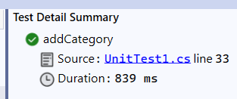
Phase 4 Test Methods
addCategory
[Test]
public void addCategory() //ToTest that addition of Category record
{
var _dbContext = CreateDbContext();
UnitOfWork unitOfWork = new UnitOfWork(_dbContext);
var sut = new CategoryRepository(_dbContext);
var category = new Category { Name = "Test1", Description = "Test1 Description" };
sut.Add(category);
_dbContext.SaveChanges();
var result = sut.GetAll();
int id22 = 0;
foreach (var item in result)
{
id22 = item.Id;
}
Assert.AreEqual(1, id22);
_dbContext.Dispose();
}

Slide 2
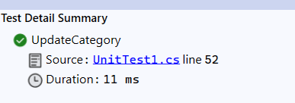
Phase 4 Test Methods
updateCategory
public void UpdateCategory() //Test Update of Category record
{
var _dbContext = CreateDbContext();
UnitOfWork unitOfWork = new UnitOfWork(_dbContext);
var sut = new CategoryRepository(_dbContext);
var category = new Category { Name = "Test1", Description = "Test1 Description" };
sut.Add(category);
_dbContext.SaveChanges();
category.Description = "Test1 Description Updated";
sut.Update(category);
_dbContext.SaveChanges();
var check= unitOfWork.Category.GetT(p => p.Id == category.Id);
Assert.AreEqual("Test1 Description Updated", check.Description);
_dbContext.Dispose();
}

Slide 3
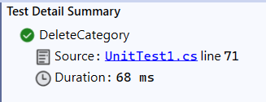
Phase 4 Test Methods
deleteCategory
public void DeleteCategory() //Test Deletion of Category record
{
var _dbContext = CreateDbContext();
UnitOfWork unitOfWork = new UnitOfWork(_dbContext);
var sut = new CategoryRepository(_dbContext);
var category = new Category { Name = "Test1", Description = "Test1 Description" };
var result = sut.AddT(category);
_dbContext.SaveChanges();
sut.Delete(category);
_dbContext.SaveChanges();
var isExists = unitOfWork.Category.GetT(p => p.Id == result.Id);
//Assert.IsFalse(isExists);
Assert.AreEqual(null, isExists);
_dbContext.Dispose();
}

Slide 4
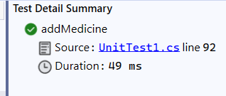
Phase 4 Test Methods
AddMedicine
public void addMedicine()
{
var _dbContext = CreateDbContext();
UnitOfWork unitOfWork = new UnitOfWork(_dbContext);
//Add Category Record
var sut = new CategoryRepository(_dbContext);
var category = new Category { Name = "Test1", Description = "Test1 Description" };
sut.Add(category);
int id22 = 0;
var result = sut.GetAll();
foreach (var item in result)
{
id22 = item.Id;
}
var med = new MedicineRepository(_dbContext);
var medicine = new Medicine { Name = "Test1", Description = "Test1 Description",Price=10, CategoryId=id22};
med.Add(medicine);
_dbContext.SaveChanges();
var result1 = med.GetAll();
int id33 = 0;
foreach (var item in result1)
{
id33 = item.CategoryId;
}
Assert.AreEqual(id33, id22);
_dbContext.Dispose();
}

Slide 5
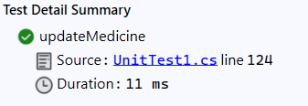
Phase 4 Test Methods
updateMedicine
public void updateMedicine()
{
var _dbContext = CreateDbContext();
UnitOfWork unitOfWork = new UnitOfWork(_dbContext);
//Add Category Record
var sut = new CategoryRepository(_dbContext);
var category = new Category { Name = "Test1", Description = "Test1 Description" };
sut.Add(category);
int id22 = 0;
var result = sut.GetAll();
foreach (var item in result)
{
id22 = item.Id;
}
var med = new MedicineRepository(_dbContext);
var medicine = new Medicine { Name = "Test1", Description = "Test1 Description", Price = 10, CategoryId = id22 };
med.Add(medicine);
_dbContext.SaveChanges();
medicine.Price = 20;
med.Update(medicine);
var result2 = med.GetById(medicine.Id);
Assert.AreEqual(20, result2.Price);
_dbContext.Dispose();
}

Slide 6
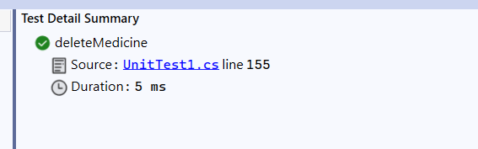
Phase 4 Test Methods
deleteMedicine
public void updateMedicine()
{
var _dbContext = CreateDbContext();
UnitOfWork unitOfWork = new UnitOfWork(_dbContext);
//Add Category Record
var sut = new CategoryRepository(_dbContext);
var category = new Category { Name = "Test1", Description = "Test1 Description" };
sut.Add(category);
int id22 = 0;
var result = sut.GetAll();
foreach (var item in result)
{
id22 = item.Id;
}
var med = new MedicineRepository(_dbContext);
var medicine = new Medicine { Name = "Test1", Description = "Test1 Description", Price = 10, CategoryId = id22 };
med.Add(medicine);
_dbContext.SaveChanges();
medicine.Price = 20;
med.Update(medicine);
var result2 = med.GetById(medicine.Id);
Assert.AreEqual(20, result2.Price);
_dbContext.Dispose();
}

